Slide 1
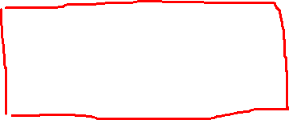
QPSK
Quadrature Phase Shift Keying
A form of PSK where two bits are transmitted at a time or two bits are modulated at a time
Bandwidth is greater than PSK
Data is grouped or paired, each pair is called a dibit (00,01,10,11)
00----0 degree or 45 degree
01----90 degree or 135 degree
10----180 degree or 225 degree
11----270 degree or 315 degree
QPSK can carry twice amount of data than BPSK
Applications: Satellite communication, 4G/5G communication, WiFi

Slide 2
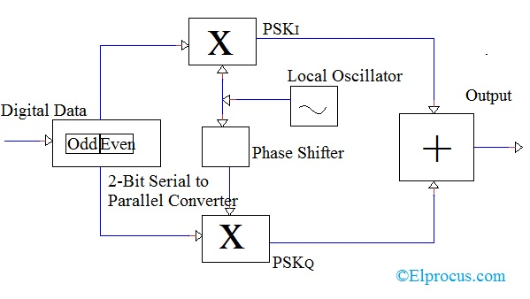
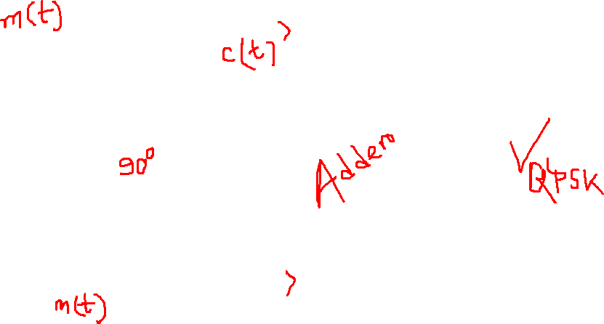
0 1 1 1 0

Slide 3
